Slide 1








TRACKING WELLNESS: FITNESS AND NUTRITION
TEAM MEMBERS :
ANJALI DEVI LEDALLA
HOSSEIN TASHAKORI
HARITHA KASARANENI
MOUNISH REDDY DODDA
HO

Slide 2

INTRODUCTION
People have started prioritizing their personal wellness so there is now more demand for improved fitness and nutrition monitoring tools.
A large number of fitness and nutrition apps exist without offering a clear analysis between exercise activities and dietary patterns.
An analysis of user health data through our project creates meaningful insights to fill the current gap.

Slide 3
PROBLEM STATEMENT
The Issue: Existing fitness trackers are either on physical exercise or diet but lack an integrated strategy. Users have no idea how their exercises affect their dietary requirements and vice versa.
Our Approach: Using the data visualization to get the correlations between fitness activity and diet. Perform correlation analysis among the workout type, calorie consumption, heart rate, and steps taken.

Slide 4
METHODOLOGY-DATA ABSTRACTION
Data Selection:
Choosed the relevant dataset from Kaggle and downloaded.
Data Extraction & Data Preprocessing:
The dataset was obtained from Kaggle and verified through structure validation (CSV, Excel or JSON) before checking completeness with Excel tools.
The Power Query Editor feature in Power BI enabled us to execute data cleanup operations such as filling empty values while standardizing formatting standards and validating data types to ensure consistency.
Correlation analysis & Data Visualization:
We use different plots such as scatter plots to display important relationships between variables.
Creating interactive dashboards by using the graphs and filters provide essential insights.

Slide 5
WORKFLOW
01
02
03
04
05
Data Import
Data Exploration
Data Preprocessing
Correlational Analysis
Data Visualizations
Understand various graphs and key variables like consumer count, workout type, etc
Clean and handle the missing values. Standardize the data using PowerQuery Editor
Plotting various plots like scatter plot to visualise key relationship between the variables
Import Data from kaggle to Power BI
Creating dashboard to present the key insights

Slide 6
DATA ABSTRACTION
The data includes well-organized rows containing specific fitness information wherein each record has its own distinct variables such as workout types and consumed calories along with sleep duration.
Attributes (Columns/Features):
Date: Fitness data entry date.
Workout_Type: Type of workout (e.g., cardio, strength training).
The count of daily consumed calories represents Calories_Consumed.
Workout_Duration: Duration of workout (minutes).
Sleep_Hours: Number of hours slept.
Mood: Mood status (e.g., happy, tired).
Place_of_Workout: Location of workout (e.g., gym, home).
Heart_Rate: Average heart rate during workout.
Data Source : Fitness dataset by Arnavsmayan from kaggle
https://www.kaggle.com/datasets/arnavsmayan/fitness-tracker-dataset
.

Slide 7
DATA ABSTRACTION
Cleaning:
Remove duplicates and irrelevant records.
The correction of data types includes proper handling for numeric values that need proper formatting.
Handling Missing Values:
Mean/median can impute numerical features which include calories and workout duration among others.
Inputing categorical features such as mood or workout type by choosing mode or placing unknown values.
Normalization/Standardization:
Each numerical piece of data (workout duration, calories) needs normalization to establish equivalent measurement scales during analysis.

Slide 8
TASK ABSTRACTION
Key Questions
Actions Taken
Which factors determine the relation between workout intensity levels and calorie usage?
Does visual pattern exists between heart rate measurements and step counts.
How much impact does workout types have on sleep
The research used aggregation, filtering and correlation analysis of the data.
The fitness data undergoes trend detection analysis through Power BI.

Slide 9



Scatter Plot and Heatmap
Two analytical tools that help recognize associations of fitness metrics include Scatter Plots and Heatmaps which measure relationships between heart rate as well as calorie consumption and workout results.
Kaggle :
Extracted datasets from Kaggle containing fitness and nutrition data which is of .csv format
Bar Charts
Bar Charts reveal the comparison of calorie consumption during exercises that take place at different locations and with various workout types.
TOOLS AND TECHNOLOGIES
Power Query Editor – Power BI
For Data cleaning and preprocessing, checked for null values and replaced them with the mean of the column data using Power Query.
Line Graphs
Deliver information about the ongoing patterns of heart rate together with sleep duration and calorie usage throughout time.
Power BI – Visualization Dashboard
For obtaining the correlational analysis of the dataset, used Power Bi to create various visualizations to get the meaningful insights.
Pie Charts
Provide a visual breakdown of heart rate averages by workout type.

Slide 10
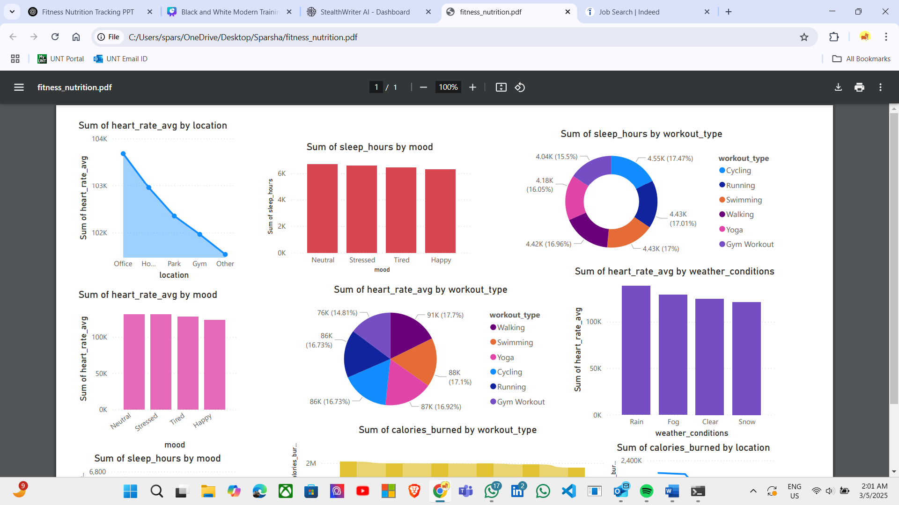
VISUALIZATIONS :
AVG HEART RATE AGAINST
Location
Mood
Workout Type
The highest heart rates appear in office areas while heart rates decrease steadily from office to home and then to parks and gyms and other locations
.The results demonstrate that working environments generate increased heart rates than the stress-reducing areas of parks and gyms.
Heart rate stays consistent at normal levels for people who are neither distressed nor tired while stress and tiredness cause heart rates to increase.
Heart rate variations prove to be directly influenced by emotional well-being of the individual.
Heart rates increase during walking and running while yoga and swimming practice keep heart rates at lower levels.
The intensity levels across different exercises vary strongly with each other.

Slide 11
VISUALIZATIONS :
SLEEP HOURS AGAINST
Mood
Workout Type
People who maintain neutral, happy or tired moods tend to obtain more restful sleep yet those under stress usually do not achieve enough rest.
The research provides evidence that stress negatively affects the length of nighttime res
Participating in yoga and swimming activities leads to increased sleep length but the influence of intensive exercises such as running and gym activities remains uncertain.
Evidence reveals that performing calming physical exercises generates superior nighttime rest quality.

Slide 12
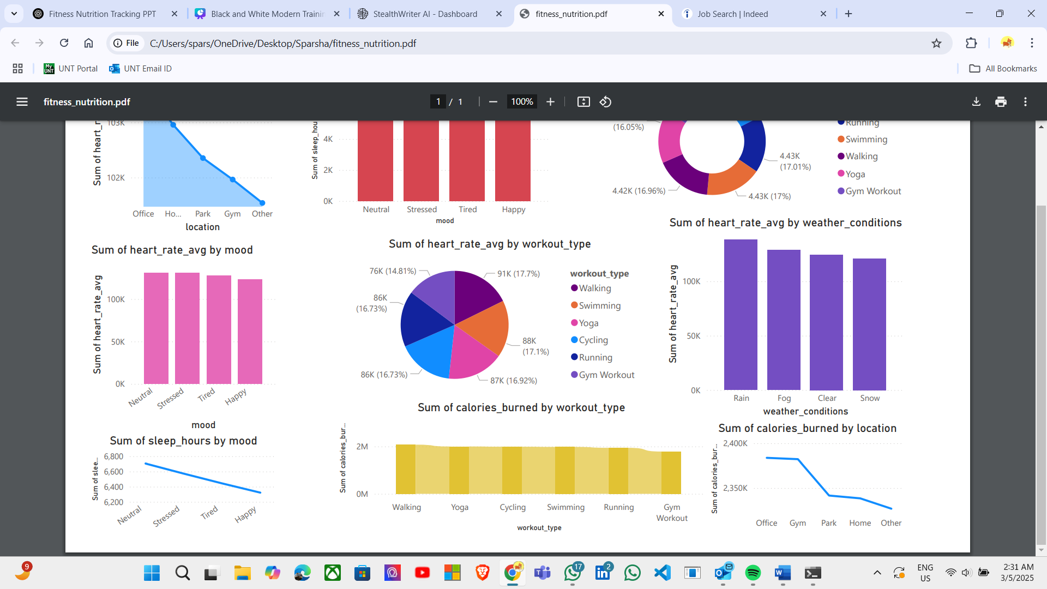
VISUALIZATIONS :
CALORIES BURNT AGAINST
Workout Type
Location
The maximum calorie burn happens during running and walking exercise and cycling and swimming follow.
The minimal calorie expenditure made by yoga confirms that this practice belongs to the category of low-intensity workouts.
Resistance workouts that occur in gyms along with outdoor sessions produce increased calorie expenditure than home-based exercise routines.
Workout areas specifically designed for exercise produce better physical activity results in individuals.

Slide 13
Correlational Analysis and Key Findings
Calorie intake vs Workout Performance : Workout performance receives better results from increased calorie consumption because of their positive relationship.
Heart Rate vs Step Count : The relation between heart rate and step count helps determine endurance levels because elevated step counts boost heart rate values that show cardiovascular activity.
Sleep Duration vs Calories Burnt : Energy levels improve when people sleep longer since it enhances their calorie burning effectiveness.
Heart Rate vs Workout Type : The heart rate tends to rise higher among gym and running workouts yet yoga practices sustain a more stable and lower heart rate.
Calories burnt vs Workout Type : Workout activities such as running and gym exercises deliver the most substantial calorie expenditure results to the body.
Calories burnt vs Location : Exercise performance in outdoor gym facilities and park areas produces superior calorie expenditure than workouts that take place within home environments.
Heart Rate vs Weather : Heart rate measurements did not depend on weather conditions since heart rate trends remained steady throughout rain and clear and foggy weather.
Mood vs Heart Rate : Heart rate measurements show higher value in stressed individuals yet people with positive mood sustain stable heart rates.
Sleep hours vs Mood : people who experience stress usually sleep less than those in better mood states thus affecting their recovery process.

Slide 14

Challenges & Work Management
Challenges Faced:
Inaccurate workout logs and missing data.
Time constraints for data visualization and cleaning.
Team Responsibilities:
Anjali Devi Ledalla: Data gathering -Contributed100%
Hossein Tashakori:data cleaning and preprocessing -Contributed100%
Haritha Kasaraneni: visualisations & correlational analysis. -Contributed100%
Mounish Reddy Dodda: Dashboard integration & Report documentation -Contributed-100%

Slide 15
Next Steps for Project 2
Expanding Analysis:
Merging fitness & nutrition information for more insight.
Using Pearson & Spearman correlation for enhanced statistical analysis.
Transition from static to interactive visualization.
Webpage Development:
Creating an interactive webpage to display insights using D3.js.
Integrating Tableau or Power BI dashboard for interactivity.

Slide 16
THANK YOU VERY MUCH!

